Slide 1
EMI Predict AI
Intelligent Financial Risk Assessment Platform

Slide 2
Problem Statement
The Issues: Borrowers often face financial distress due to poor planning; traditional underwriting is slow and manual.Add your first bullet point here
The Goal: Build an automated, real-time platform to assess 400,000 profiles across 5 EMI scenarios (E-commerce, Home, Vehicle, Personal, Education).

Slide 3
Project Architecture
Pipeline Flow:
Data Preprocessing (400k records)
Feature Engineering (22 variables)
MLflow Experiment Tracking (Model Selection)
Streamlit Cloud Deployment

Slide 4
Data Processing & EDA
Dataset Scale: 400,000 records.
Quality Checks: Resolved mixed-type warnings and fixed "bad lines" (tokenization issues). Show the correlation between credit_score and emi_eligibility. Mention the use of the df variable for data handling.
Key Findings:

Slide 5
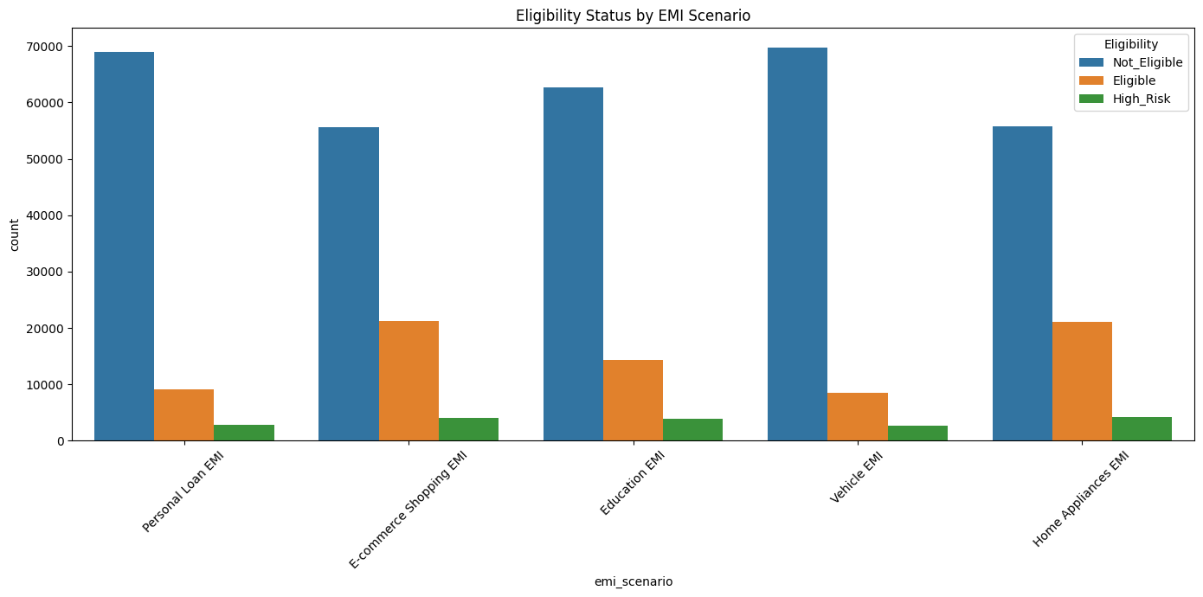
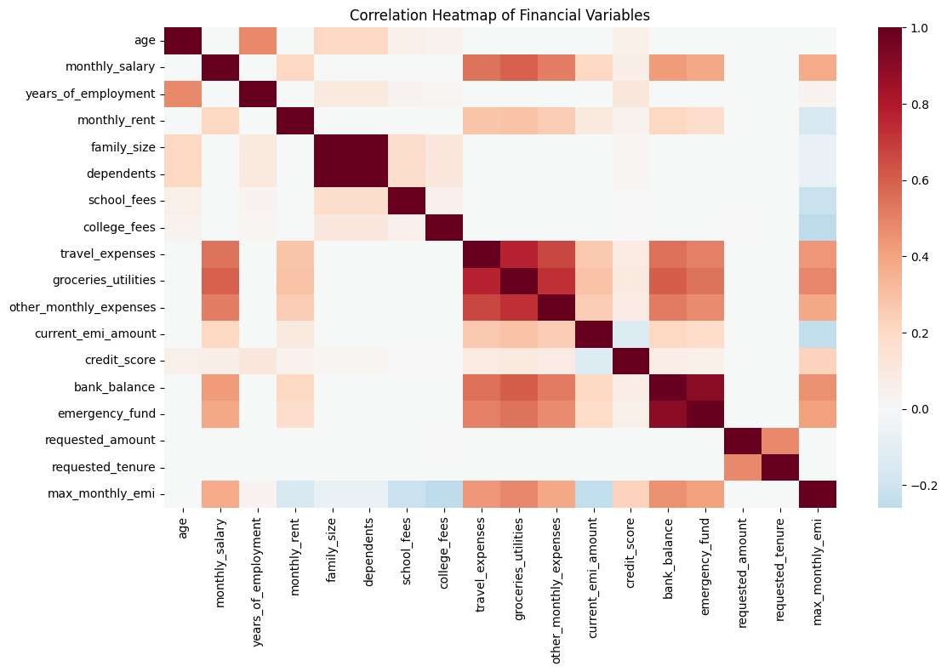
EDA
Study correlation between financial variables and loan approval rates

Slide 6
Feature Engineering
Derived Ratio : Debt-to-Income, Expense-to-Income, and Affordability Index.
Calculated Target : Maximum EMI Capacity (calculated as 40% of disposable income).
Scaling : Standard Scaling applied to financial variables for model stability.
Develop interaction features between key financial variables

Slide 7
MLflow Experiment Tracking
Classification
Regression
Classification (Eligibility): Compared Logistic Regression, Random Forest, and XGBoost.
Regression (Max EMI): Compared Linear Regression, Random Forest, and Gradient Boosting.
Tracking: Logged hyperparameters and metrics (Accuracy, R2, MAE) for all models.

Slide 8
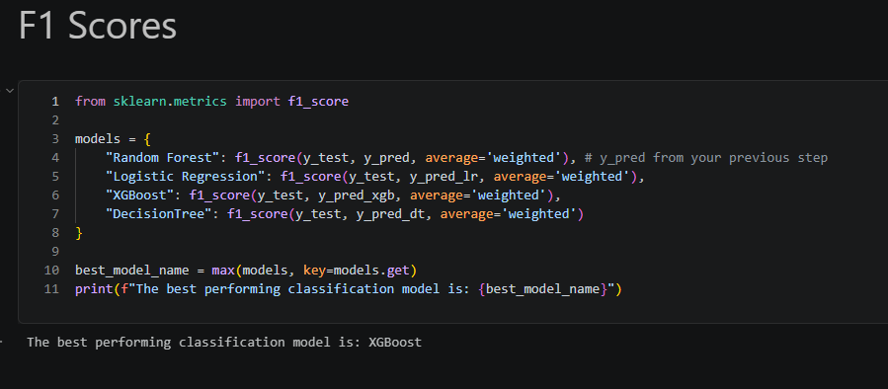
Model Evaluation
Classification Results: Accuracy > 90% using XGBoost.
Regression Results: Low MAE/RMSE for EMI amount prediction.
Selection: The best models were registered in the MLflow Model Registry for production deployment.

Slide 9
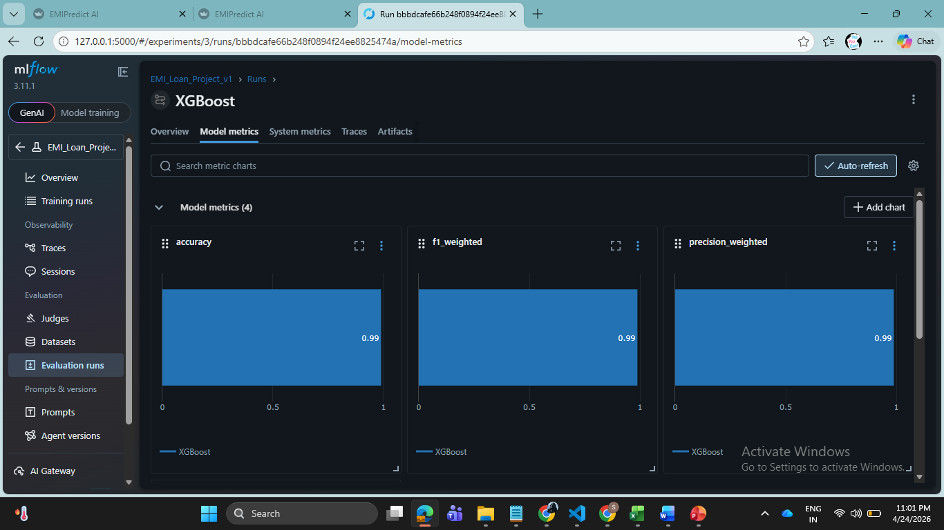
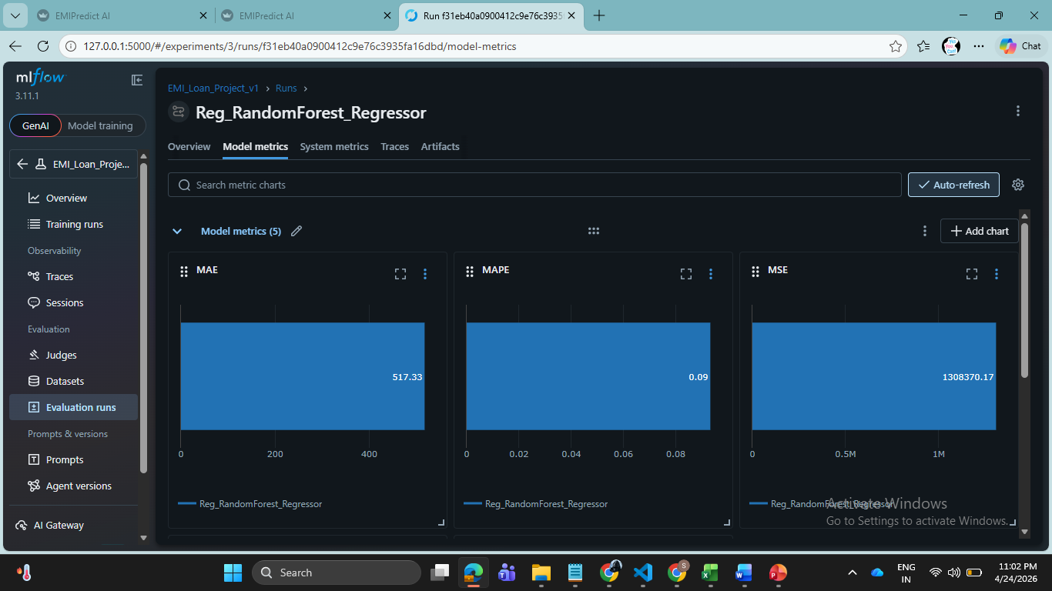
ML Trainging Runs
XG Booster
Reg_RandomForest_Regressor

Slide 10
The Streamlit Application

Slide 11
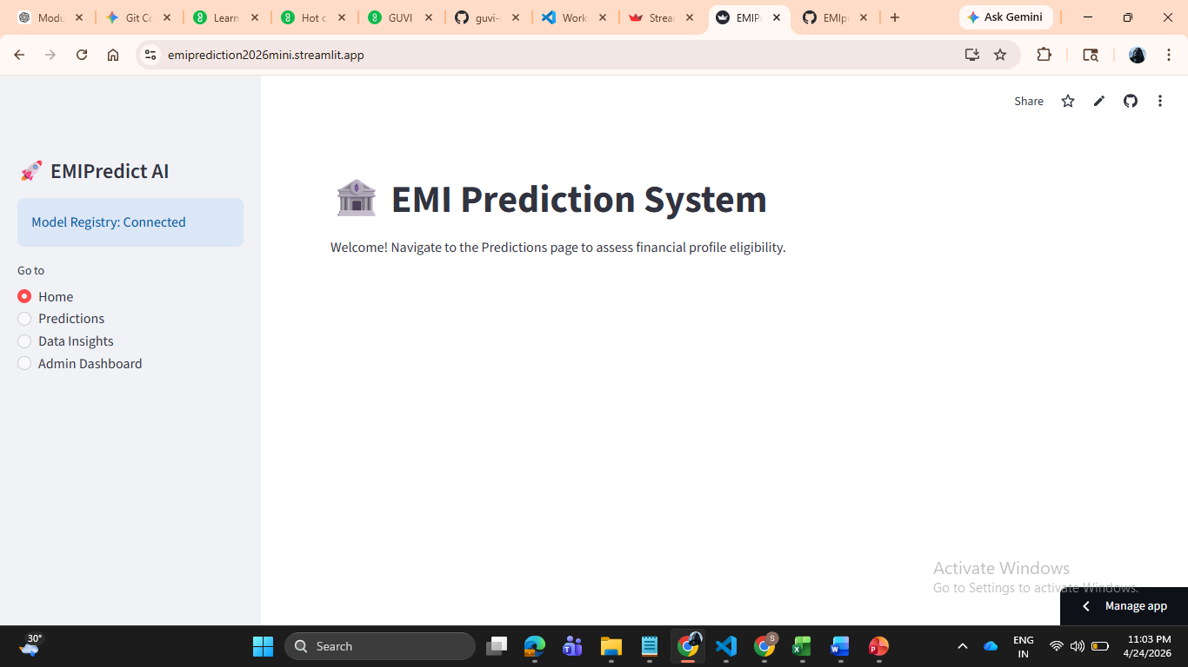
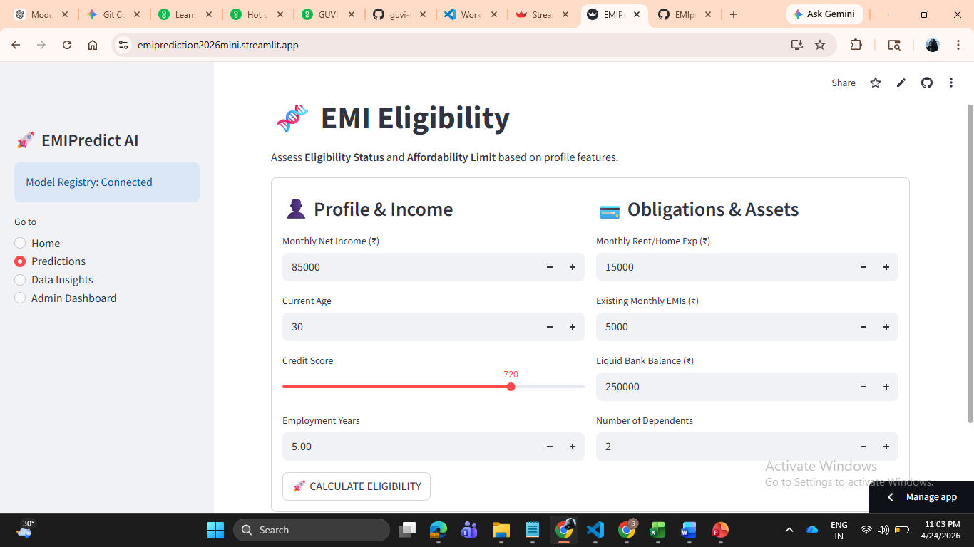
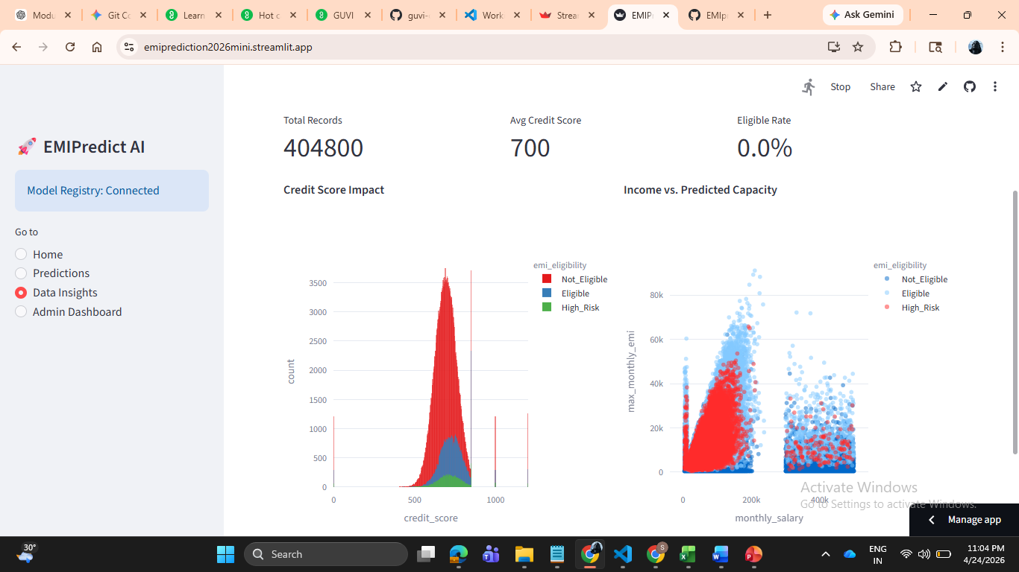

Slide 12
Deployment & Production
CI/CD : Automatic sync between GitHub and Streamlit Cloud.
Scalability: Responsive design for cross-platform accessibility.
URL : https://emiprediction2026mini.streamlit.app/

Slide 13
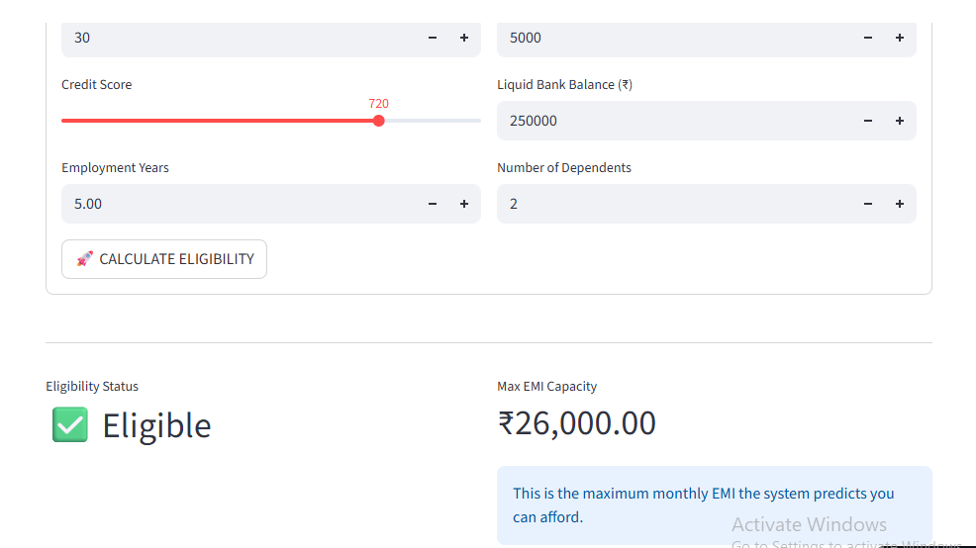
Business Impact
Efficiency: 80% reduction in manual underwriting time.
Risk Management: Real-time identification of "High Risk" applicants.
Accuracy: Standardized decision-making across all 5 loan scenarios.

Slide 14


